Slide 1


UE17MC602
Cloud Computing
Mr. Tamal Dey
Dept. of MCA,PESU
1

Slide 2
What Is Cloud Computing? Questions
What are the facilities provided by the cloud?
What are the benefits of Cloud Computing?
Identify and explain different evaluation of web.
How semantic web and informatic explosion works?
Differentiate and describe Web 2.0 and Web 3.0.
What are the aspects of future evaluation?
Describe different characteristics of Cloud with example.
Explain virtualization concept and types with example.
How virtualization and cloud computing is related?
What is Hypervisor? Explain use of each types.
Explain cloud deployment model with example.
Explain different service models with example.
Name few market players and services provides in Cloud.

Slide 3
Explain Cloud Architecture with a neat diagram.
Describe the merits and demerits of using different business driver in cloud.
What are the technological challenges faced by cloud computing? Explain.
Describe multitenancy with an example.
Describe different design principles followed by cloud.

Slide 4
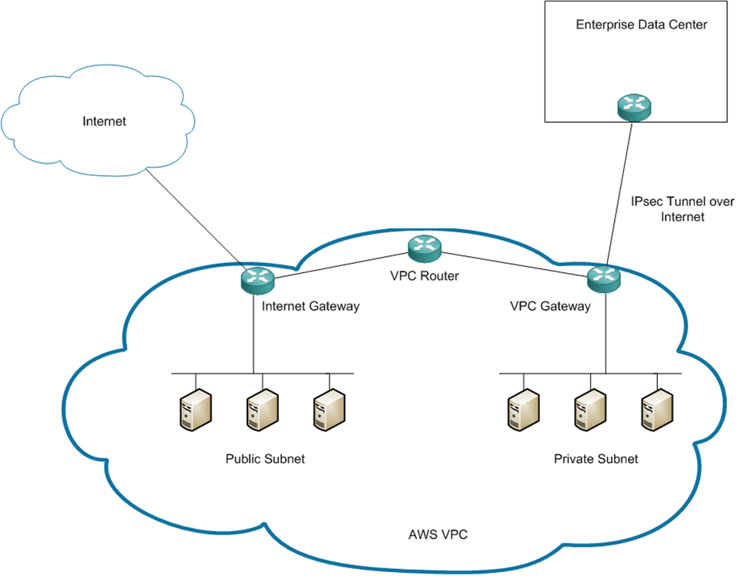
Why the Name Cloud?
The term “Cloud” came from a network design that was used by network engineers to represent the location of various network devices and their inter-connection. The shape of this network design was like a cloud.

Slide 5
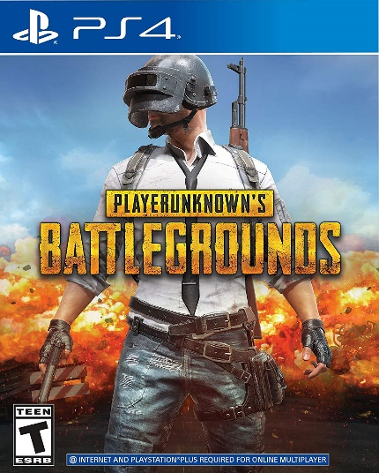
Cloud Gaming
Cloud gaming is an online game distribution.
The most common methods of cloud gaming currently are video (or pixel) streaming and file streaming.
Cloud gaming, also in some cases called "gaming on demand
E.g. http://www.pubgonthecloud.com/,
Play Station Now-PS4 , GeForce, Vortex, Paperspace
Everyday life activities such as
Banking, Email, Media Streaming, and Ecommerce all use the Cloud.
On the Business side, Applications, Infrastructure, Storage, Sales/CRM use Cloud services
Notes:
https://hackernoon.com/how-to-play-pubg-on-aws-db2e75fa599b

Slide 6
What Is Cloud Computing?
Cloud computing is the on-demand delivery of IT resources and applications via the Internet with pay-as-you-go pricing.
Whether you run applications that share photos to millions of mobile users or deliver services that support the critical operations of your business, the cloud provides rapid access to flexible and low-cost IT resources.
With cloud computing, you don’t need to make large up-front investments in hardware and spend a lot of time managing that hardware.
Instead, you can provision exactly the right type and size of computing resources you need to power your newest bright idea or operate your IT department.
With cloud computing, you can access as many resources as you need, almost instantly, and only pay for what you use.

Slide 7
Why Cloud?
A Business Case of e-commerce industry
Amazon needs 1000 more servers during Diwali to accommodate high number of users visiting the website and after that period it does not need those servers.
Solution
Cloud is the solution with dynamic ways to scale up and scale down the services when required
Cloud computing means data is stored at a remote place and is synchronized with other web information
7

Slide 8
Example
Whenever you travel through a bus or train, you take a ticket for your destination and hold back to your seat till you reach your destination.
Likewise other passengers also takes ticket and travel in the same bus with you and it hardly bothers you where they go.
When your stop comes you get off the bus thanking the driver. Cloud computing is just like that bus, carrying data and information for different users and allows to use its service with minimal cost.
Notes:
https://www.guru99.com/cloud-computing-for-beginners.html

Slide 9
Advantages
In its simplest form, cloud computing provides an easy way to access servers, storage, databases, and a broad set of application services over the Internet.
Cloud computing providers the own and maintain the network-connected hardware required for these application services, while you provision and use what you need for your workloads.
a revolutionary shift in how technology
how organizations budget and pay for technology services.
To reconfigure the computing environment quickly to adapt to changing business requirements can optimize spending.
Capacity can be automatically scaled up or down to meet fluctuating usage patterns.

Slide 10
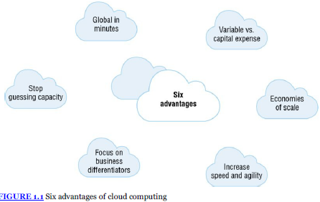
Services can be temporarily taken offline or shut down permanently as business demands dictate.
In addition, with pay-per-use billing, AWS Cloud services become an operational expense instead of a capital expense.
While each organization experiences a unique journey to the cloud with numerous benefits.
Notes:
Agility: ability to move quickly and easily.

Slide 11
Six advantages of cloud computing
Variable vs. Capital Expense: The ability to trade capital expense for variable operational expense. Instead of having to invest heavily in data centers and servers before knowing how you’re going to use them.
Economies of Scale: The organizations benefit from massive economies of scale. By using cloud computing, you can achieve a lower variable cost than you would get on your own. Thousands of customers use which translates into lower prices.
Stop Guessing Capacity: The Company often end up either sitting on expensive idle resources or dealing with limited capacity. With cloud computing, organizations can stop guessing about capacity requirements for the infrastructure necessary to meet their business needs by scale-up or scale-down the resources.

Slide 12
Increase Speed and Agility: In Cloud Computing New IT resources allows organizations to reduce the time it takes to make those resources available to developers from weeks to just minutes. This results in a dramatic increase in speed and agility for the organization.
Focus on Business Differentiators: Cloud computing allows organizations to focus on their business priorities, instead of on the heavy lifting of racking, stacking, and powering servers. Organization can stop spending money on running and maintaining data centers.
Go Global in Minutes: The ability to go global in minutes. Organizations can easily deploy their applications to multiple locations around the world with just a few clicks and satisfy customer needs.

Slide 13
Course Outline
Credits: 04 |  | Contact Hours:56 |  |  | Autonomy Course
Type of learning: |  | Apply based | Apply based | 40-50% practice sessions | Remaining Concept Learning
Evaluation Pattern
 | Components |  | CBT | Practical | Scale to
ISA:60 | T1 | 10 | 20 | 20 | 20
 | T2 | 10 | 10 | 30 | 20
 | Assignment |  |  |  | 10
 | Deployment |  |  |  | 10
ESA:40 | Theory |  |  | 40 | 15
 | Exercise based Evaluation |  |  | 60 | 25
13

Slide 14
Agenda
Unit 1 - Introduction
Unit 2 - IaaS
Unit 3 - PaaS
Unit 4 - SaaS
Unit-5 –Cloud for latest technologies
14

Slide 15
Reading Resources
Text Books
Dinkar Sitaram & Geetha Manjunath, Moving to the cloud, Elsevier
Publications, 2011. [ Unit 1,2,3,4,5 Chapter 1 -4 , Chapter 7-9]
“AWS Certified Solutions Architect Official Study Guide", Joe Baron, Hisham Baz, John Wiley & Sons, Reprint 2017.
Aurobindo Sarkar & Amit shah, Learning AWS, Packt publishing, second edition, 2018. [ Unit 1 - Chapter 1 ]
References
Srinivasan A & Suresh J, Cloud Computing: A Practical Approach for Learning and Implementation, Pearson Education, 2014.
15

Slide 16
Unit 1
Agenda
Evolution of the web
Cloud Computing
Cloud Deployment models
Business drivers for cloud computing
Cloud technologies – Service Models
Designing Multi-tenancy
Design principles
Emerging cloud based application architectures
Lab: Setting up your AWS account.
16

Slide 17
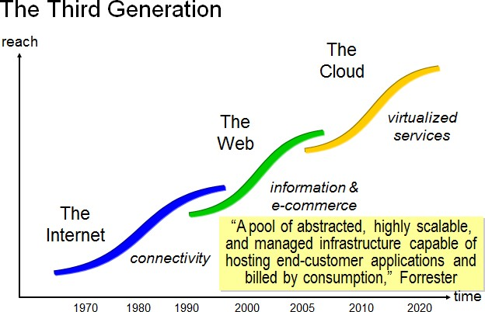
Where are we now?
17

Slide 18
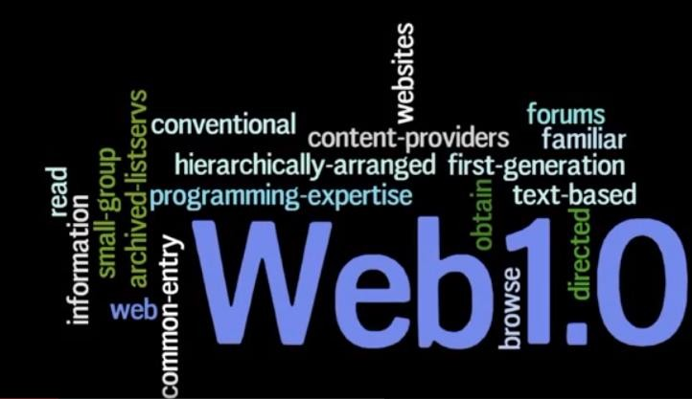
18

Slide 19
Evolution of the Web
Internet based computing – 1990s – web 1.0
Displays information
Just a gigantic (huge) library
Read only
Web 2.0 and Social networking
2000s – rapid growth – Digital reality
Applications that allowed users to upload information to the web – user generated content
It looks like a Virtual world
Read and write – reviews, tags, ratings, annotations and blogs
Bcoz of this, Data is exploding – Hence Mining was ultimately
required
19
Notes:
750 million in 2011 to 1.59 billion in June 2019

Slide 20
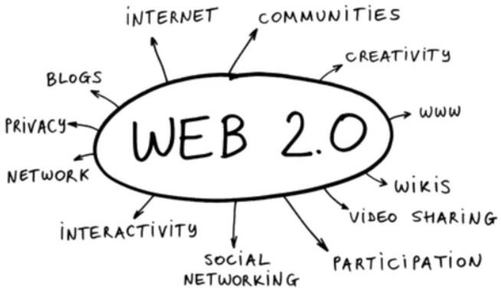
20

Slide 21
Semantic Web - Web 3.0
Information Explosion
Mobile devices made web accessible from anywhere, anytime and on any device
Google maps, location-based services, augmented reality applications….
Mobile devices are therefore computationally powerful having touch, accelerometer and other sensors
Mobile vendors are also providing cloud services (icloud, skydrive) to host app data and make available on multiple personal devices of the user.
21
Notes:
What is the use of accelerometer sensor?
An accelerometer is an electromechanical device used to measure acceleration forces. Such forces may be static, like the continuous force of gravity or, as is the case with many mobile devices, dynamic to sense movement or vibrations. Acceleration is the measurement of the change in velocity, or speed divided by time.
https://www.digitaltrends.com/mobile/how-to-use-ar-mode-google-maps/

Slide 22
Future Evaluation- aka the Cloud
Cloud will continue to be a huge information source
Greater storage of personal data and profiles with immense interaction bring the digital world closer to the real world.
Mobility makes the Web available everywhere increasing intensity
Cloud platforms have already made it possible to harness large amounts of computing power to analyze large amounts of data.
The new applications will be accessible on multiple heterogeneous devices, including mobile devices
22
Notes:
aka: also known as

Slide 23
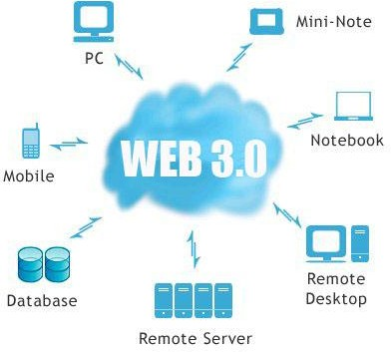
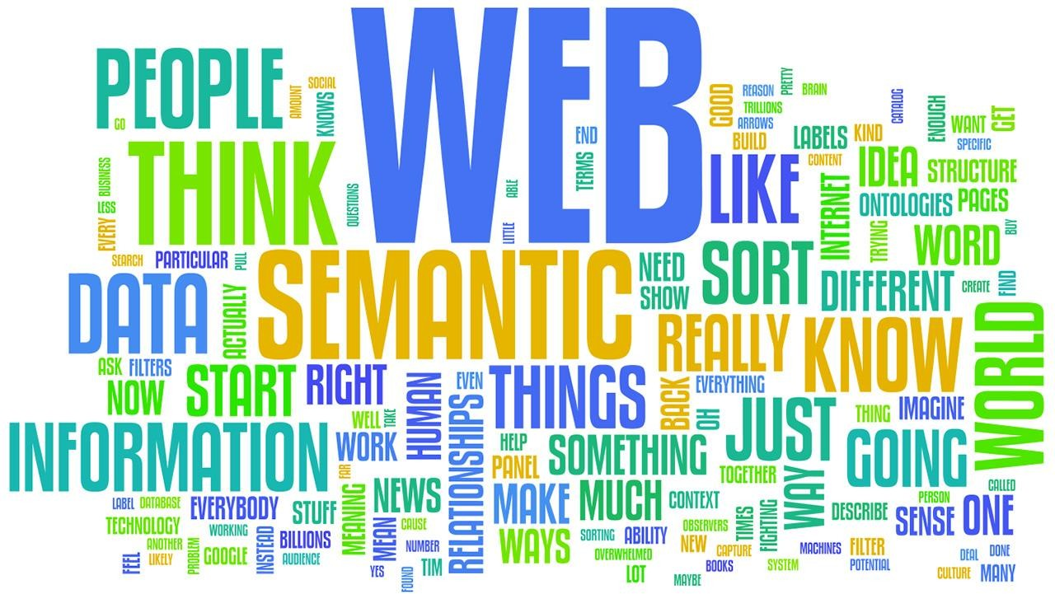
23
Notes:
Semantic: relating to meaning in language or logics

Slide 24
Scenario: Web 3.0 (Cheshire Constabulary)
A recent report states that by use of face recognition software to analyze photos, one can discover the name, birthday, and other personal information about people from Facebook. E.g. grocery stores- CCTV
Customer data that can be analyzed to derive great insights into the buying behavior, buying pattern and even methods to counteract competitors
Businesses can use the location of people, together with personal information, to better serve customers, as certain mobile devices keep detailed logs of the location of their users.
Due to all these reasons and more, the next generation Web, Web 3.0, has been humorously called “Cyberspace looks at You”

Slide 25
Web 2.0 vs Web 3.0
Feature | Web 2.0 | Web 3.0
Communication | Interaction | Engaged/Invested
Information | Dynamic | Portable and personal
Focus | Community | Individual
Personal Interest | Blogs/wikis/social media | Livestreams
Content | Sharing | Exhibition
Interaction | Interacts with web applications | Interacts with smart applications
Searching | Keywords/tags | Context/relevance
Advertising | Interactive | Behavioural
Technologies | Flash, Java, XML | RDF, RDFS, OWL RDF – resource description framework OWL – ontology web language
13
Notes:
RDF is a standard model for data interchange on the Web. RDF has features that facilitate data merging even if the underlying schemas differ.
RDF Vocabulary Description Language 1.0: RDF Schema (RDFS).
Ontology Web Language (OWL) is a set of markup languages which are designed for use by applications that need to process the content of information instead of just presenting information to humans.

Slide 26
In short
Web 1.0 – sharing of information – one way
Web 2.0 – interaction – two way
Web 3.0 – Intelligent and omnipresent (widespread) – three way (web server interacts intelligently)
26
Notes:
Omnipresent- widely or constantly encountered; Present everywhere at the same time (God)

Slide 27
Current/Future Evolution
More sophisticated applications that can analyse the data stored in the cloud
More intelligent and rich user interactive applications is quite possible
The user should not bother about the infrastructure, platform, libraries and application deployment
It should be automated and abstracted
Business can leverage cloud computing is through the
wisdom of crowds for better decision making
E,g. - The Hollywood Stock Exchange (HSX) is an online game that is a good example of crowd wisdom
27

Slide 28
Why Cloud?
A Business Case of e-commerce industry
Amazon needs 1000 more servers during Diwali to accommodate high number of users visiting the website and after that period it does not need those servers.
Solution
Cloud is the solution with dynamic ways to scale up and scale down the services when required
Cloud computing means data is stored at a remote place and is synchronized with other web information
28

Slide 29
News
Prepping For The Inevitable Move To The Cloud
Venkat Malladi - Co-founder/CTO at Vymo. Former member of the Google Mobile team. Alum of BITS Pilani and Columbia University-May 18, 2018, 09:30am @ community voice, Forbes Technology council
50% of the global enterprises rely on cloud
AI and machine learning will be the leading catalysts (67%) that will drive adoption of cloud technologies by the year 2020.
83% of the enterprise workload will be on the cloud by that same year, with 41% of the workload running on public cloud platforms (up from the current 31%).
29
Notes:
https://www.forbes.com/sites/forbestechcouncil/2018/05/18/prepping-for-the-inevitable-move-to-the-cloud/#6164b627e878

Slide 30

“Facepalm”
30
Notes:
A facepalm is the physical gesture of placing one's hand across one's face or lowering one's face into one's hand or hands, covering or closing one's eyes. The gesture is often exaggerated by giving the motion more force and making a slapping noise when the hand comes in contact with the face

Slide 31
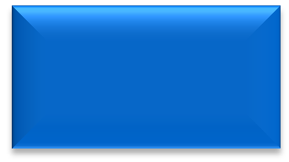
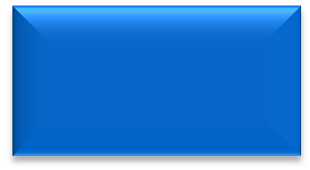




The cloud (r)evolution: solving problems that current technology models can’t solve
Service providers
Service users
Services and data break apart
New connections
Information relevance
Multi-tenant applications
New capabilities
Flexible
consumption
Existing apps and infrastructure
New access EaaS
Contract-based consumption
Technology over the internet
19
Notes:
Multi tenant applications allow you to serve multiple customers with one install of the application. Each customer has their data completely isolated in such an architecture. Each customer is called a tenant.
EaaS- Enterprise as a Service

Slide 32
What is Cloud Computing?
Cloud computing is a model for enabling ubiquitous, convenient, on-demand network access to shared pool of configurable computing resources that can be rapidly provisioned and released with minimal management effort service provider interaction.
NIST- US National Institute of Standards and Technology
32
Notes:
Ubiquitous- present, appearing, or found everywhere. Pronounce- yoo·bi·kwuh·thus
Provisioned- supply resources and equipment, especially for a journey.

Slide 33
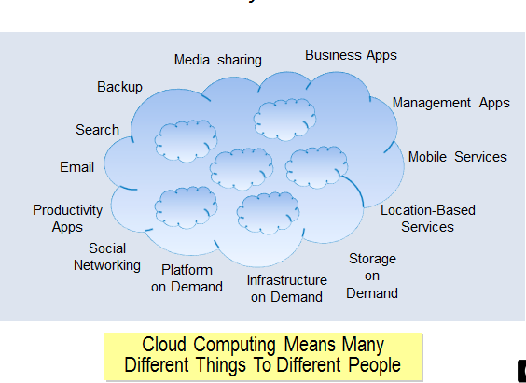
Everything as a Service
33

Slide 34
Characteristics of Cloud
On-demand – compute, storage or platform are self provisioned or auto provisioned
Broad network access - Ubiquitous access from desktops, laptops or mobiles – develop light applications
Resource pooling – share resources (h/w) - millions of concurrent users eg: skype, facebook
Rapid elasticity –increase or decrease the computing resources as needed
Measured service –pay as you go
Resiliency – the capacity to recover from failures
34
Notes:
1. Elastic Compute Cloud
2. Yahoo, Google, Amazon
3. Skype: 27 million Concurrent user, Facebook: 7 Million(2009). 2.41 billion monthly active users as of the second quarter of 2019
4. EC2- Number of Virtual Server allocation
5. Commercial Cloud Services- Salesforce.com

Slide 35
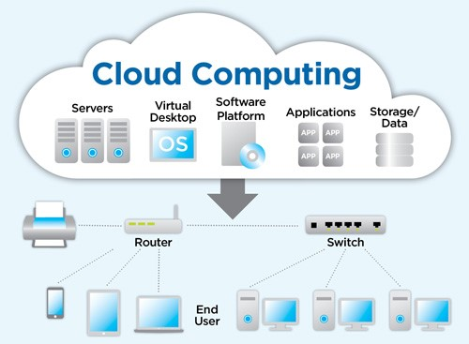
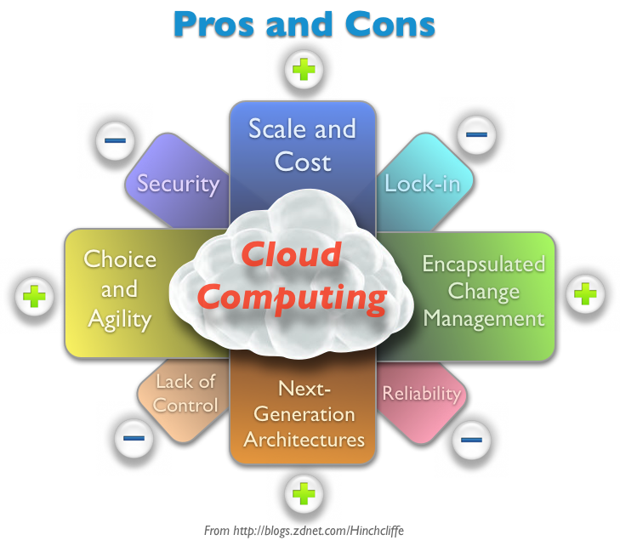

Slide 36

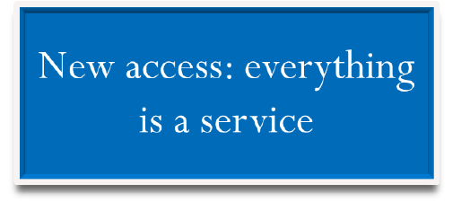
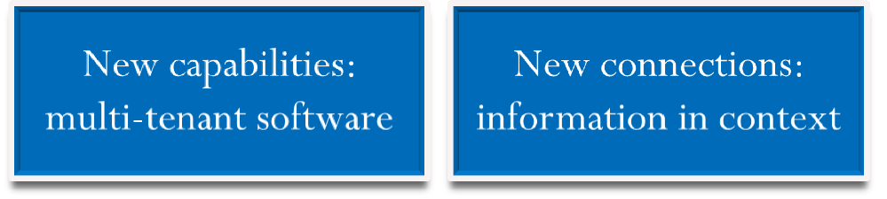
What do we mean by cloud?
Service providers
Service users
The cloud is a means by which global class, highly scalable and flexible services can be delivered and consumed over the internet through an as-needed, pay-per-use business model.
What’s new?
loud Computing, By S.Thenmozhi
C
23

Slide 37
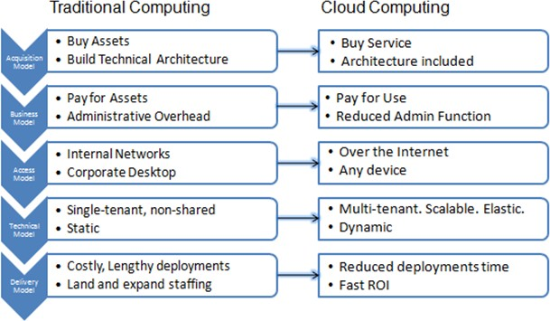
Traditional Vs Cloud Computing
Notes:
ROI - return on investment

Slide 38
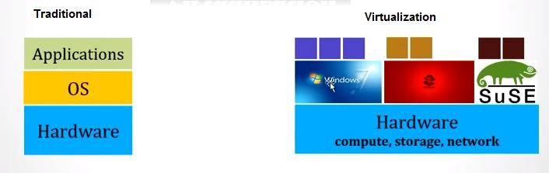
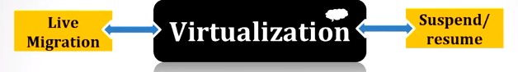
Major components of Cloud
Concept - Virtualization
Notes:
Virtualization refers to the act of creating a virtual (rather than actual) version of something, including virtual computer hardware platforms, storage devices, and computer network resources.
Migration is a way to move from one place to another in order to work.

Slide 39
OS Virtualization
Virtualization is the "creation of a virtual (rather than actual) version of something, such as a server, a desktop, a storage device, an operating system or network resources".
Virtualization provides a standard operating system so that it can run different applications handled by multiple users on a single computer at a time.
The operating systems do not interfere with each other even though they are on the same computer.
Decoupling OS from the Hardware and applications
Advantage: Fail in hardware will not affect the software.
Notes:
Virtualization is a technique, which allows to share a single physical instance of a resource or an application among multiple customers and organizations. It does by assigning a logical name to a physical storage and providing a pointer to that physical resource when demanded.

Slide 40
What is the concept behind the Virtualization?
Creation of a virtual machine over existing operating system and hardware is known as Hardware Virtualization. A Virtual machine provides an environment that is logically separated from the underlying hardware.
The machine on which the virtual machine is going to create is known as Host Machine and that virtual machine is referred as a Guest Machine
Types of Virtualization:
Network Virtualization
Storage Virtualization
Server Virtualization.
Hardware Virtualization.
Operating system Virtualization..

Slide 41
Virtualization vs. Cloud Computing
Virtualization changes the hardware-software relations and is one of the foundational elements of cloud computing technology that helps utilize cloud computing capabilities to the full.
Cloud computing refers to the service that results from that change.
It describes the delivery of shared computing resources, SaaS and on-demand services through the Internet.
Virtualization and cloud computing work together to provide different types of services

Slide 42
Virtualization types explanation
Network virtualization in cloud computing is a method of combining the available resources in a network by splitting up the available bandwidth into different channels, each being separate and distinguished. They can be either assigned to a particular server or device or stay unassigned completely.
Storage Virtualizing gives the user an ability to pool the hardware storage space from several interconnected storage devices into a simulated single storage device that is managed from one single command console. This storage technique is often used in storage area networks.

Slide 43
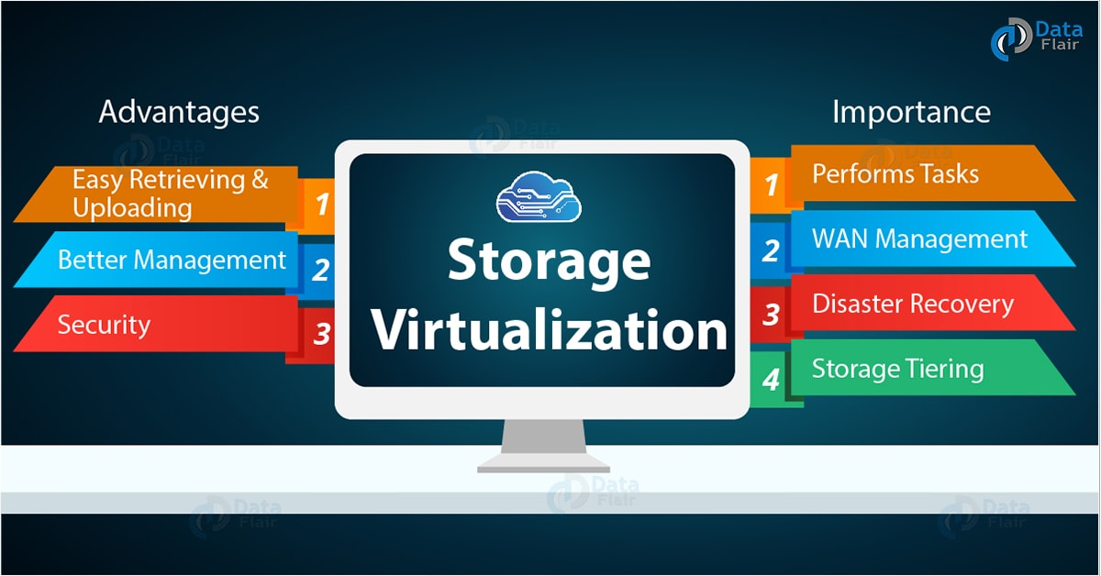
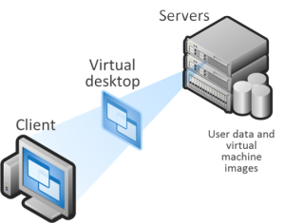
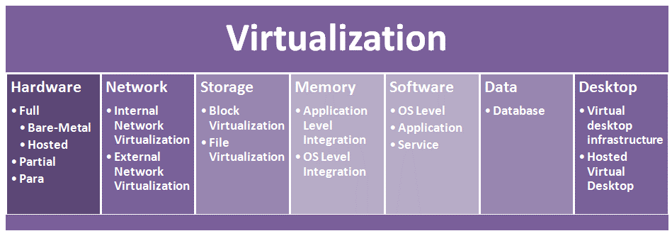

Slide 44
Server Virtualization is the masking of server resources. It simulates physical servers by changing their identity, numbers, processors and operating systems. It also makes a lot of resources available for sharing and utilizing, while maintaining the capacity to expand them when needed.
Data Virtualization is abstracting the technical details usually used in data management, such as location, performance or format that are directly related to business needs.

Slide 45
Virtualization merits and demerits
There are many benefits of Virtualization, like it optimizes hardware resource utilization, saves energy and costs and makes it possible to run multiple applications and various operating systems on the same SERVER at the same time. Provides ability to manage resources effectively.
Increases efficiency of IT operations.
Provides for easier backup and disaster recovery.
Increases cost savings with reduced hardware expenditure.
Disadvantages of virtualization are almost negligible when compared to the multiple advantages it offers.
Software licensing costs.
Necessity to train IT staff in virtualization

Slide 46
Desktop Virtualizing you to emulate a workstation load, rather than a server. This allows the user to access the desktop remotely. Since the workstation is essentially running in a data centre server, access to it can be both more secure and portable.
Application Virtualization: Software virtualization in cloud computing abstracts the application layer, separating it from the operating system. This way the application can run in an encapsulated form without being dependant upon the operating system.

Slide 47
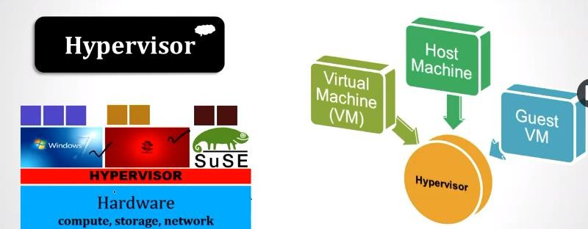
Hypervisor
Hypervisor- a piece of software which does virtualization

Slide 48
How it works?
Hypervisors are virtual machine monitor(VMM) that enables numerous virtual operating systems to simultaneously run on a computer system. These virtual machines are also referred as guest machines and they all share the hardware of the physical machine like memory, processor, storage and other related resources. This improves and enhances the utilization of the underlying resources.
The hypervisor isolates the operating systems from the primary host machine. The job of a hypervisor is to cater to the needs of a guest operating system and to manage it efficiently. Each virtual machine is independent and do not interfere with each another although they run on the same host machine.

Slide 49
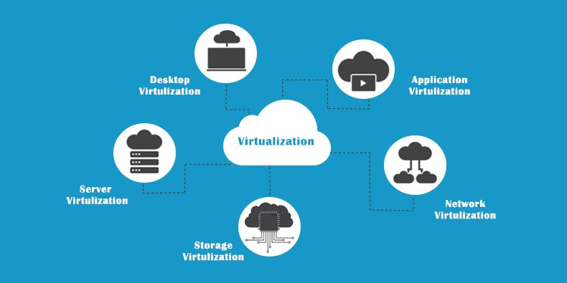
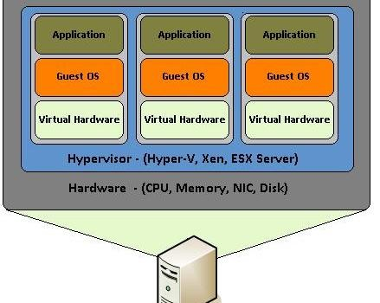
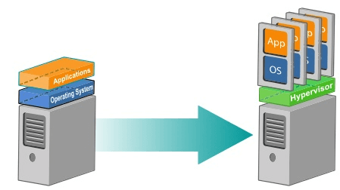

Slide 50
Hypervisors are divided into two types:
Type one is the bare-metal hypervisor that are deployed directly over the host's system hardware without any underlying operating systems or software.
Some examples of the Type 1 hypervisors are Microsoft Hyper-V hypervisor, VMware ESXi, Citrix XenServer.
Type 2 is a hosted hypervisor that runs as a software layer within a physical operating system.
The hypervisor runs as a separate second layer over the hardware while the operating system runs as a third layer.
The hosted hypervisors include Parallels Desktop and VMware Player.
Notes:
This software is known as a Hypervisor, also known as a virtualization manager. It sits between the hardware and the operating system, and assigns the amount of access that the applications and operating systems have with the processor and other hardware resources.
For more:
https://www.znetlive.com/blog/virtualization-in-cloud-computing/

Slide 51
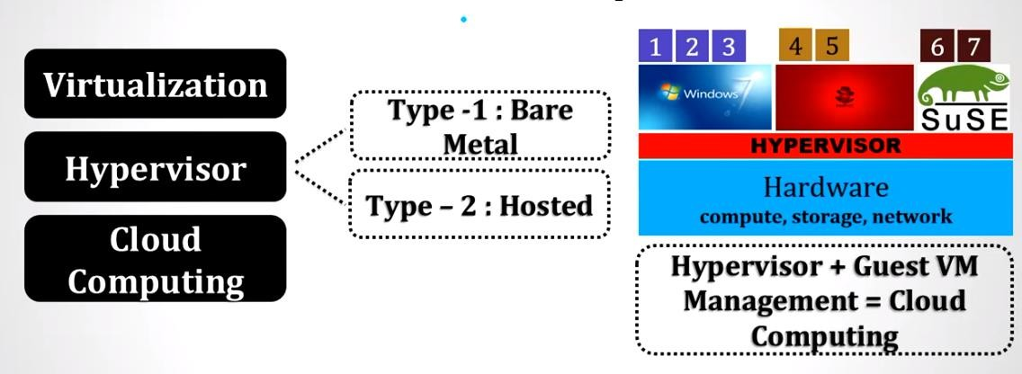
Types of Hypervisors

Slide 52
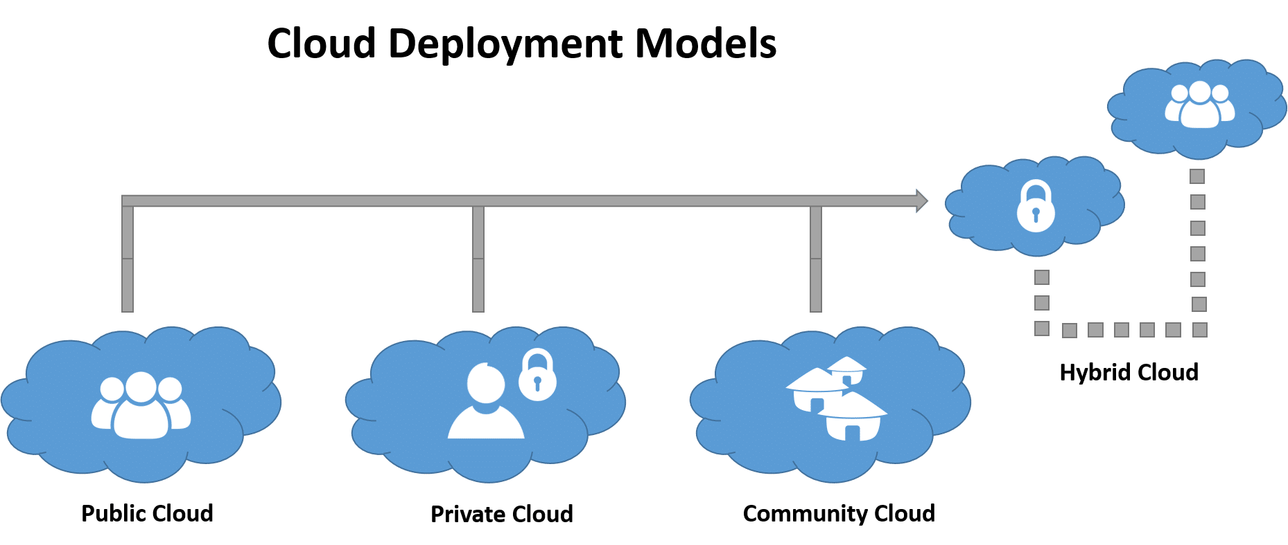
CLOUD DEPLOYMENT MODELS
In addition to proposing a definition of cloud computing, NIST has defined four deployment models for clouds
Private Cloud
Public Cloud
Community Cloud
Hybrid Cloud.

Slide 53
Private cloud is a cloud computing infrastructure that is built for a single enterprise. It is the next step in the evolution of a corporate data center of today where the infrastructure is shared within the enterprise.
Community cloud is a cloud infrastructure shared by a community of multiple organizations that generally have a common purpose.
An example of a community cloud is OpenCirrus, which is a cloud computing research testbed intended to be used by universities and research institutions.
Public cloud is a cloud infrastructure owned by a cloud service provider that provides cloud services to the public for commercial purposes. E.g. NewCloud

Slide 54
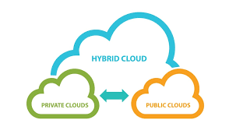
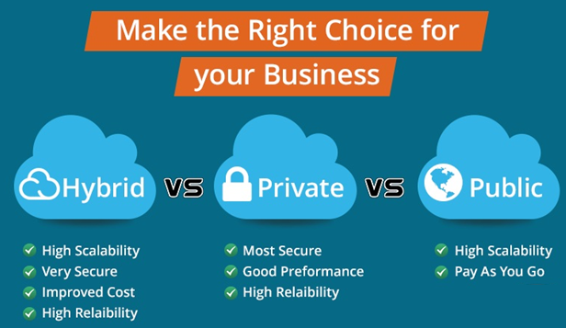
Hybrid clouds are mixtures of these different deployments.
For example, an enterprise may rent storage in a public cloud for handling peak demand.
The combination of the enterprise’s private cloud and the rented storage then is a hybrid cloud.

Slide 55
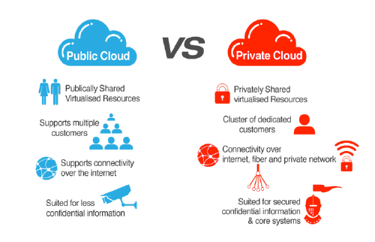
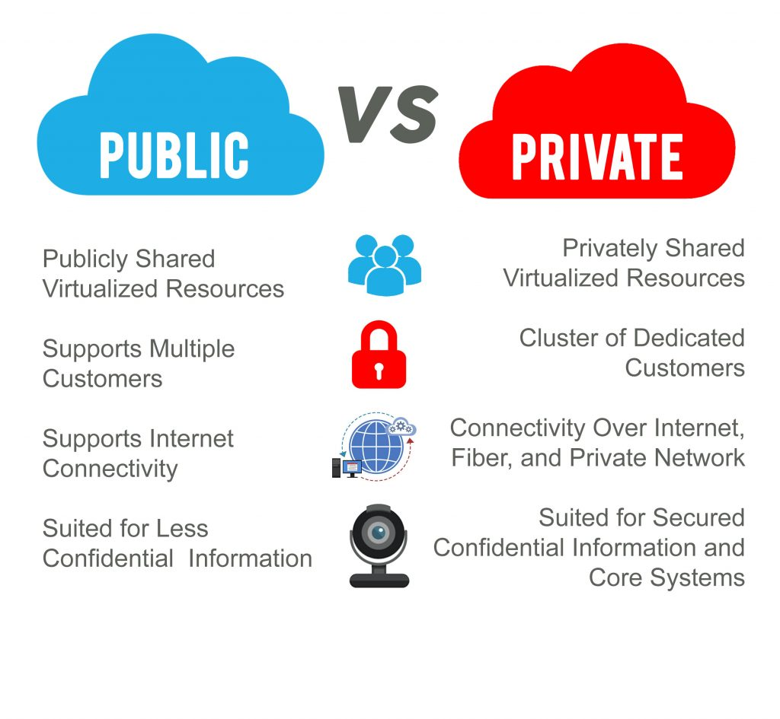
Private vs. Public Cloud

Slide 56
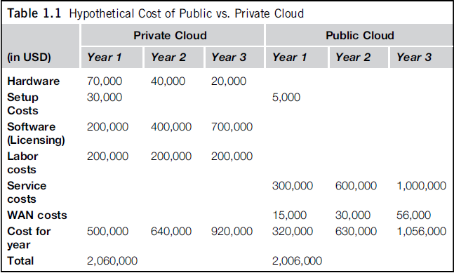
Cost Comparison 2011

Slide 57
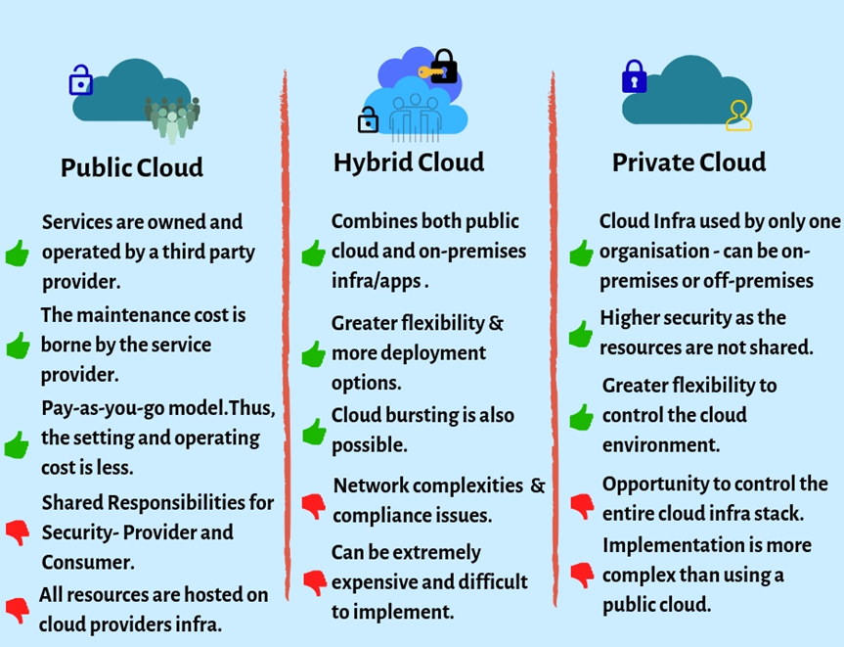
Notes:
https://www.cloudhealthtech.com/blog/differences-between-public-private-hybrid-cloud

Slide 58
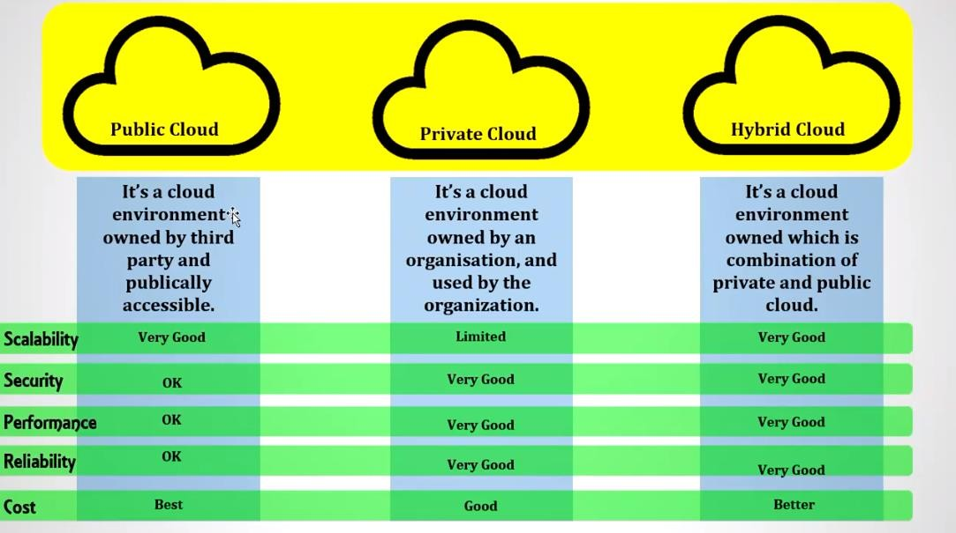
Cloud Deployment models

Slide 59
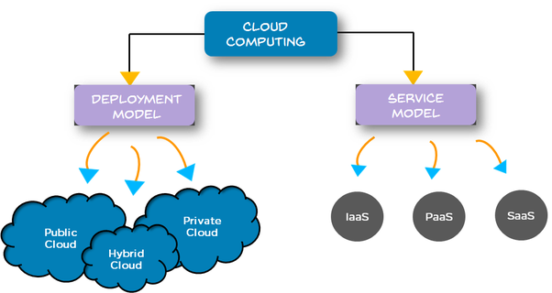
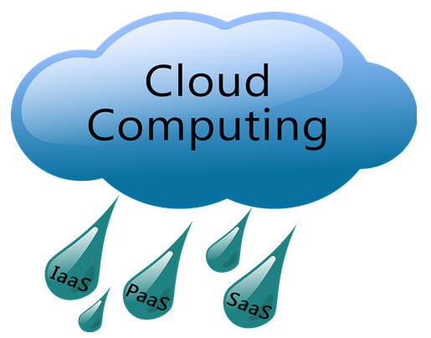
Cloud Service Models /Technologies
IaaS
PaaS
SaaS
Example: AWS, Azure, Google Cloud

Slide 60
IaaS
Infrastructure as a Service (IaaS): The consumer uses "fundamental computing resources" such as processing power, storage, networking components or middleware.
Infrastructure as a Service (IaaS) means you're buying access to raw computing hardware over the Net, such as servers or storage. Since you buy what you need and pay-as-you-go, this is often referred to as utility computing.
Market Players
Notes:
Infrastructure as a Service (IaaS) means you're buying access to raw computing hardware over the Net, such as servers or storage. Since you buy what you need and pay-as-you-go, this is often referred to as utility computing. Ordinary web hosting is a simple example of IaaS: you pay a monthly subscription or a per-megabyte/gigabyte fee to have a hosting company serve up files for your website from their servers.

Slide 61
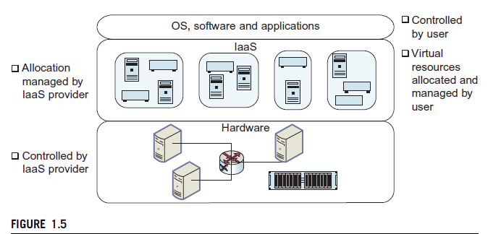
IaaS
The consumer can control the operating system, storage, deployed applications and possibly networking components such as firewalls and load balancers, but not the cloud infrastructure beneath them. E.g. web hosting (Hostinger, Siteground etc.)

Slide 62
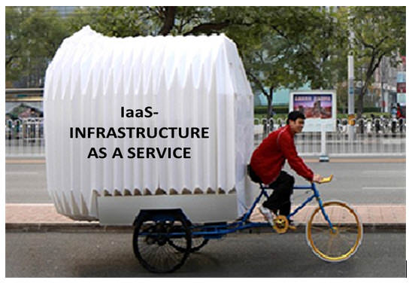
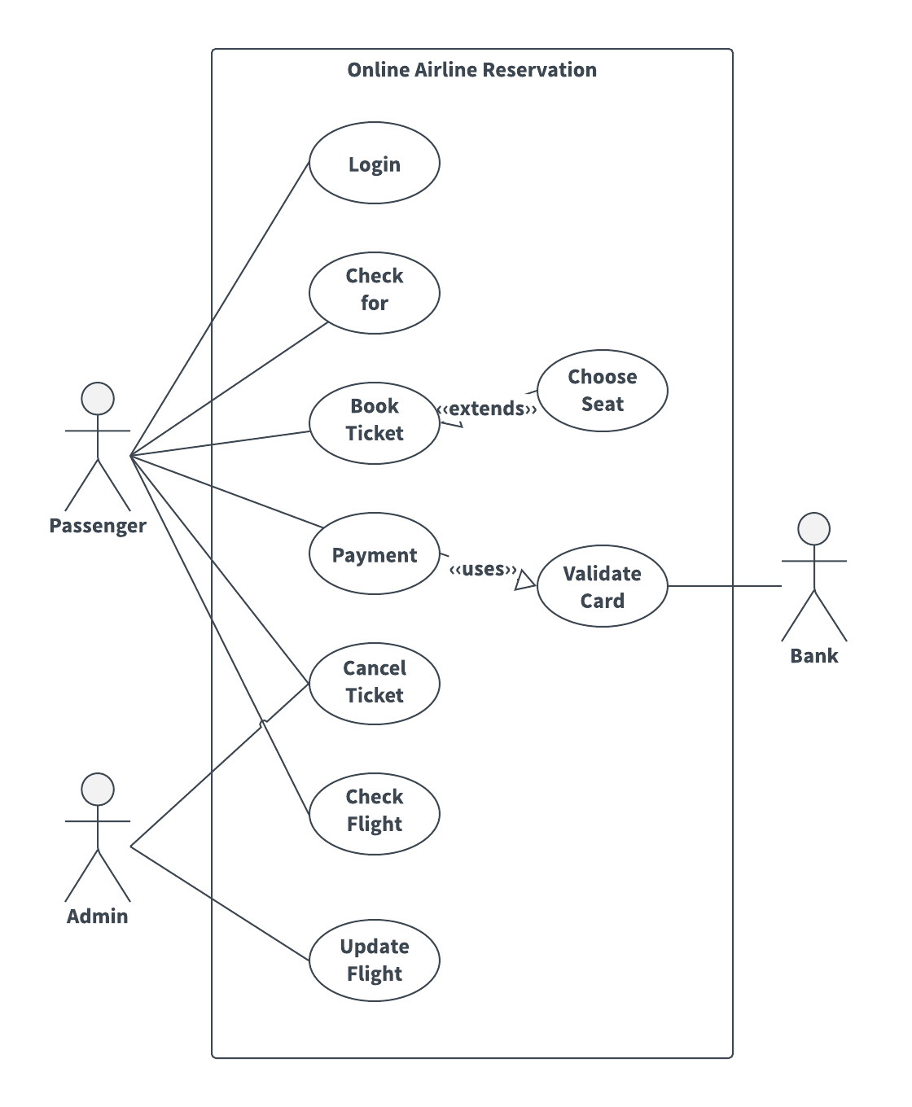
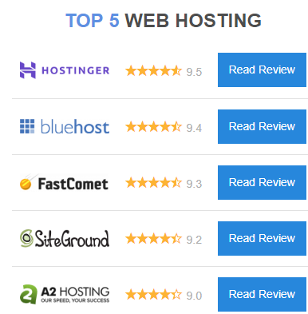
IaaS

Slide 63
Use case: A company that provides platform for online ticket booking system for airlines
The company may have their own OS, DB, Http Server
User can use a normal browser and access the http server to fetch the information from the website
In this scenario, the company don’t want to own the necessary infrastructure – storage, computing and networking
Cloud service providers – can provide the infrastructure for the airlines ticket booking system.
User can get on-demand virtual server, and able to run any service i.e, OS and applications.

Slide 64
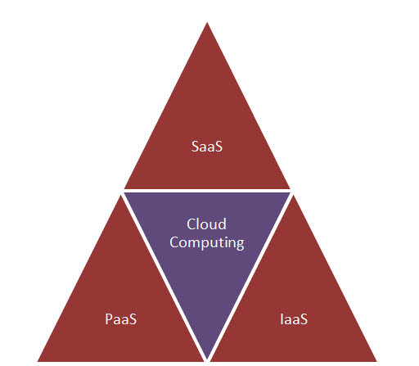
The capability provided to the consumer is to provision processing, storage, networks, and other fundamental computing resources.
Consumer is able to deploy and run arbitrary software, which can include operating systems and applications.
The consumer does not manage or control the underlying cloud infrastructure but has control over operating systems; storage, deployed applications, and possibly limited control of select networking components (e.g., host firewalls).

Slide 65
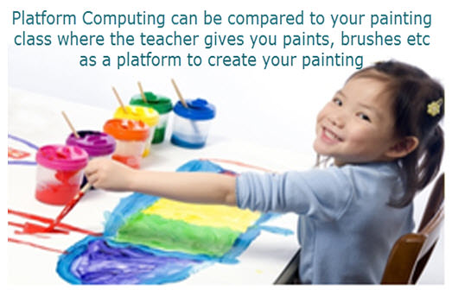
PaaS
Platform as a Service (PaaS): The consumer uses a hosting environment for their applications.
The consumer controls the applications that run in the environment but does not control the software, hardware or network infrastructure on which they are running.
E.g. App Cloud (from salesforce.com) and the Google App Engine are examples of PaaS.

Slide 66
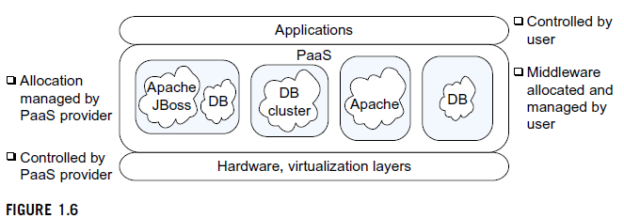
Platform as a Service (PaaS) means you develop applications using Web-based tools so they run on systems software and hardware provided by another company.
So, for example, you might develop your own ecommerce website but have the whole thing, including the shopping cart, checkout, and payment mechanism running on a merchant's server

Slide 67
PaaS
Use Case: The developer can directly use the environment for application development without bothering about underlying machine or OS.
A Developer may require for developing
Editor, complier, storage and version controlling system
Below that there is OS and a infrastructure
Cloud service provider provides, infrastructure, OS, Code base(editor, …)
In the PaaS models, cloud providers delivers the infrastructure along with platform, including operating system, programming language execution environment, database and web server etc.

Slide 68
The capability provided to the consumer is to deploy onto the cloud infrastructure consumer created or acquired Applications created using programming languages and tools supported by the provider.
The consumer does not manage or control the underlying cloud infrastructure including network, servers, operating systems, or storage, but has control over the deployed applications and Possibly application hosting environment configurations.

Slide 69
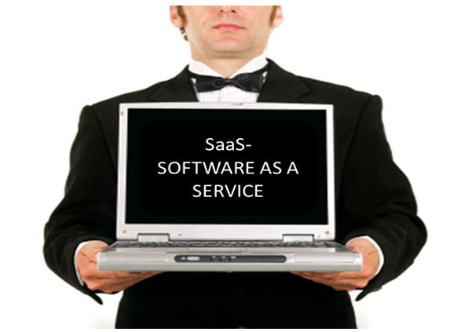
SaaS
Software as a Service (SaaS): The consumer uses an application, but does not control the operating system, hardware or network infrastructure on which it's running. E.g. Zoho is a SaaS provider offering a variety of office applications online.
In the SaaS model, cloud providers deliver the needed application required by the end user running on cloud platform and the end user need not to maintain the Hardware or the OS or the actual Application itself

Slide 70
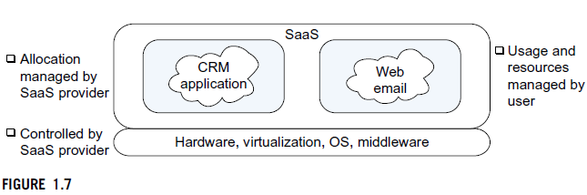
SaaS
Software as a Service (SaaS) means you use a complete application running on someone else's system. Web-based email and Google Documents are perhaps the best-known examples

Slide 71
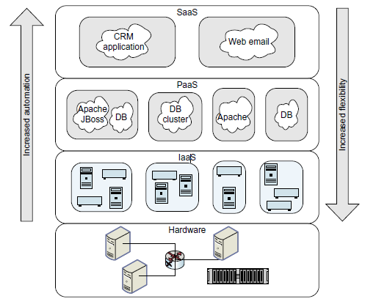
Cloud Architecture

Slide 72
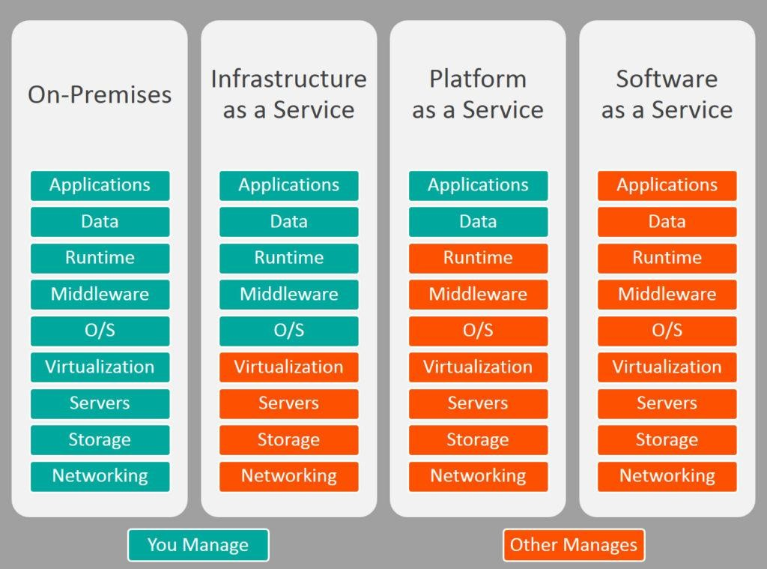

Slide 73
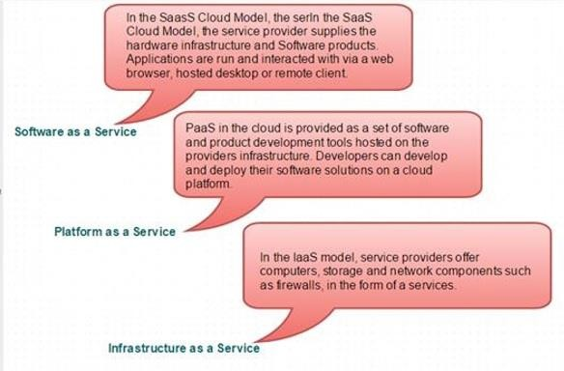
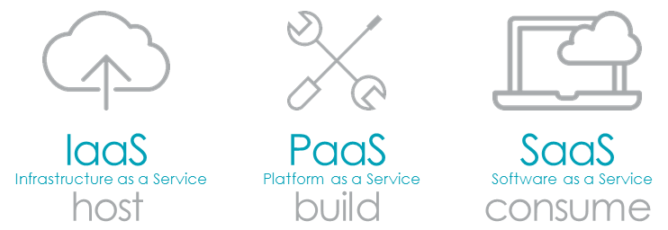

Slide 74
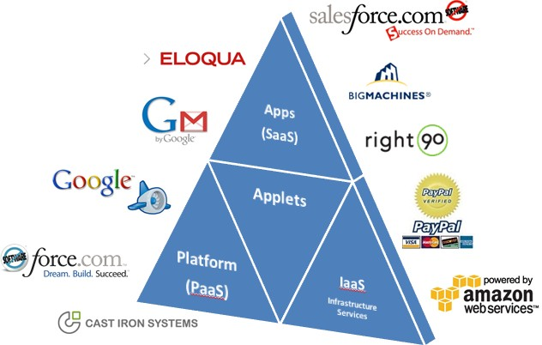
Market Players

Slide 75


Slide 76


Notes:
https://www.google.com/url?sa=i&source=images&cd=&cad=rja&uact=8&ved=2ahUKEwiJxoLimPfjAhUK3o8KHQSRC_UQjhx6BAgBEAI&url=https%3A%2F%2Fwww.intricately.com%2Fblog%2Flatin-america-cloud-market-report-h1-2018&psig=AOvVaw3iIeenmImzC9vR2XFcyY4S&ust=1565488074134993

Slide 77


Notes:
https://www.google.com/url?sa=i&source=imgres&cd=&cad=rja&uact=8&ved=2ahUKEwik37Dkl_fjAhVMiHAKHb0kCUQQjhx6BAgBEAI&url=https%3A%2F%2Fwww.zdnet.com%2Farticle%2Ftop-cloud-providers-2018-how-aws-microsoft-google-ibm-oracle-alibaba-stack-up%2F&psig=AOvVaw3c5TmAlmJYHHZ0k-gMJy8s&ust=1565488101751751

Slide 78
Advantages – Business Drivers
Scalability – scale up and down easily
Reduced Cost – pay-as-you-go
Agility – ability to rapidly provision
Automation – services are automatically attached on specifications
Backup and Recovery – replicate easily
Remote Update – access from anywhere
Resiliency – the capacity to recover from failures

Slide 79
Challenges
Security and Privacy
Regulatory and Legal issues
Inter-Operability
Performance
Portability
Reliability & Availability
Computing Performance
Service Quality-Service level Agreement

Slide 80
Break for Setting up of AWS

Slide 81

Technology Challenges for Cloud
To scale of cloud computing is much, much larger than that of traditional computing environments – as it will be shared by many users, applications, enterprises , it impact to service models.
.
Notes:
service models: SaaS, PaaS, IaaS

Slide 82
Challenges
Figure 1.8 shows dropping curve is the fraction of five Web requests that went to that web site while the V-shaped curve is the response time of the web site.
It can be seen that the top web site – Facebook.com – accounts for about 7.5% of all Web traffic. Facebook supports 7 million concurrent users(2012). (Currently 2.41 Billon)
In spite of the high traffic, the response time – close to 2 seconds – is still better than average.
To scale both compute and storage resources very rapidly need appropriate infrastructure.
New techniques for multitenancy, or fine-grained sharing of resources, are needed for supporting such large numbers of users.
Security is a natural concern in such environments as well.

Slide 83
In such large-scale environments, hardware failures and software bugs can be expected to occur relatively frequently.
The failures can trigger other failures, leading to an avalanche of failures cause outages.
Such a failure avalanche occurred once in 2011 in Amazon’s data center. A networking failure triggered a re-mirroring (making a replica or mirror) of data.
However, the re-mirroring traffic interfered (prevent) with normal storage traffic, causing the system to believe that additional mirrors had failed.
This in turn triggered further re-mirroring traffic, which interfered with additional normal storage traffic, triggering still more re-mirroring (see Figure 1.9), bringing down the whole system.
Availability is therefore one of the major challenges affecting clouds.
Notes:
Port Mirroring, also known as SPAN (Switched Port Analyzer), is a method of monitoring network traffic. With port mirroring enabled, the switch sends a copy of all network packets seen on one port (or an entire VLAN) to another port, where the packet can be analyzed.

Slide 84

Amazon’s Data Centre 2011

Slide 85
Multi-tenancy
Tenant is any legal entity responsible for data and is provided on a contractual basis. Tenant is a contract signee.
Tenant – application environment that requires isolation from
others
Multi-tenancy refers to a software architecture in which a single instance of a software runs on a server and serves multiple tenants
In short, one instance many customers.
What we want to achieve?
Reduce infrastructure costs by sharing hardware resources
Simplify software maintenance by keeping a single code base
Simplify infrastructure maintenance by having fewer nodes

Slide 86

Basic models of Multi-tenancy types

Slide 87
Shared nothing – Each customer has a separate copy of the application and the database for their exclusive use. Sometimes, the hardware is also separated from each customer for security concerns.
This is essentially for application hosting rather than application tenancy.
Shared Application – Application is shared among the customers but the databases are separate for each customer
Shared Everything – Both Application and the database are shared among all customers

Slide 88
Isolating the databases is easier and faster to build whereas shared approach includes larger development effort
Backups and restores are simpler operations in isolated approach whereas in shared approach one tenants back up may impact on other active customers.
Isolating databases may have flexibility but will give serious effects when product release or upgrades is done.

Slide 89
Applications deployment
Migrating on-premise applications to the cloud
Lift and shift
Rehosting
Building cloud native applications

Slide 90
Designing Cloud Applications
Design the application as collection of services
Data -> services ->composite services ->applications
Decouple the data
Breakout the data and processing separate
Then data and process can be on any private or public instance
Database reads and writes across the open Internet can cause latency
Consider communications between application components
combine communications into a single stream of data or a group of messages, rather than constantly communicating
Consider using caching systems.These provide additional database performance by locally storing commonly accessed data, thereby reducing all database read requests back to the physical database.
Notes:
Latency- delay before a transfer

Slide 91
-contd..
Model and design for performance and scaling
overall performance
understanding how the application will scale under an increasing load.
Make security systematic within the application
Pick a security approach and technology prior to building your application that will be effective for the type of application you’re running and that will address any compliance or other data-level security issues.

Slide 92


Slide 93
-contd..
3-tier architecture – web tier, an application or business tier, data tier
Auto-scaling and load balancers for web servers and application servers
Exhibits Master-slave database model across two different zones or data centers
The master database is synchronously replicated to the slave
Overall architecture represents a simple way to achieve highly scalable and highly available application in the cloud environment

Slide 94

AWS - Architecture
Cloud applications can be deployed in multiple locations

Slide 95
Multi-tenancy in Databases
What is more important asset to the business? - DATA
Trust between the vendor and the customer is the key factor
Tenant database is a corner-stone of the tenant management
Data architecture for multi-tenant system should be
Robust, secure, efficient, cost-effective
Three- approaches to manage multi-tenant data (database layer)
Separate database processes, shared machine
Shared database processes, separate tables
Shared table

Slide 96
-contd
Addressing data-at-rest security requirements
Tenant level
End user level
Addressing data extensibility requirements

Slide 97


Slide 98


Slide 99


Slide 100
Cloud application design principles
Designing for scale
Automating cloud infrastructure
Designing for failure
Designing for parallel processing
Designing for performance
Designing for eventual consistency

Slide 101
Emerging cloud application architectures
Batch processing: the processing of previously collected jobs in a single batch.
Streaming applications: A streaming application is a program that has its necessary components downloaded as needed instead of being installed ahead of time on a computer. Application streaming is a method of delivering virtualized applications.
Machine learning pipelines: Cloud consist of several steps to train a model, but the term ‘pipeline’ is misleading as it implies a one-way flow of data. Instead, machine learning pipelines are cyclical and iterative as every step is repeated to continuously improve the accuracy of the model and achieve a successful algorithm.

Slide 102

Spark-based Architecture

Slide 103

Lamda Architecture
Lambda architecture is a data processing architecture designed to handle massive quantities of data by taking advantage of both batch and stream-processing methods.

Slide 104

Kappa architecture
Kappa Architecture is a software architecture pattern. Kappa Architecture is a simplification of Lambda Architecture. A Kappa Architecture system is like a Lambda Architecture system with the batch processing system removed. To replace batch processing, data is simply fed through the streaming system quickly.

Slide 105

Machine pipelining

Slide 106
End of Unit 1
106
Copy protected with PDF-No-Copy.com

